Slide 1

Debate & Group Discussion

Slide 2
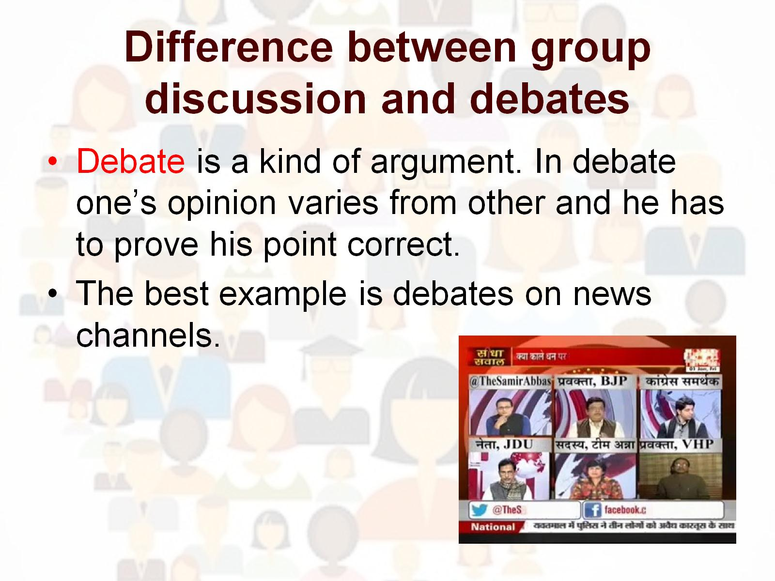
Difference between group discussion and debates

Slide 3
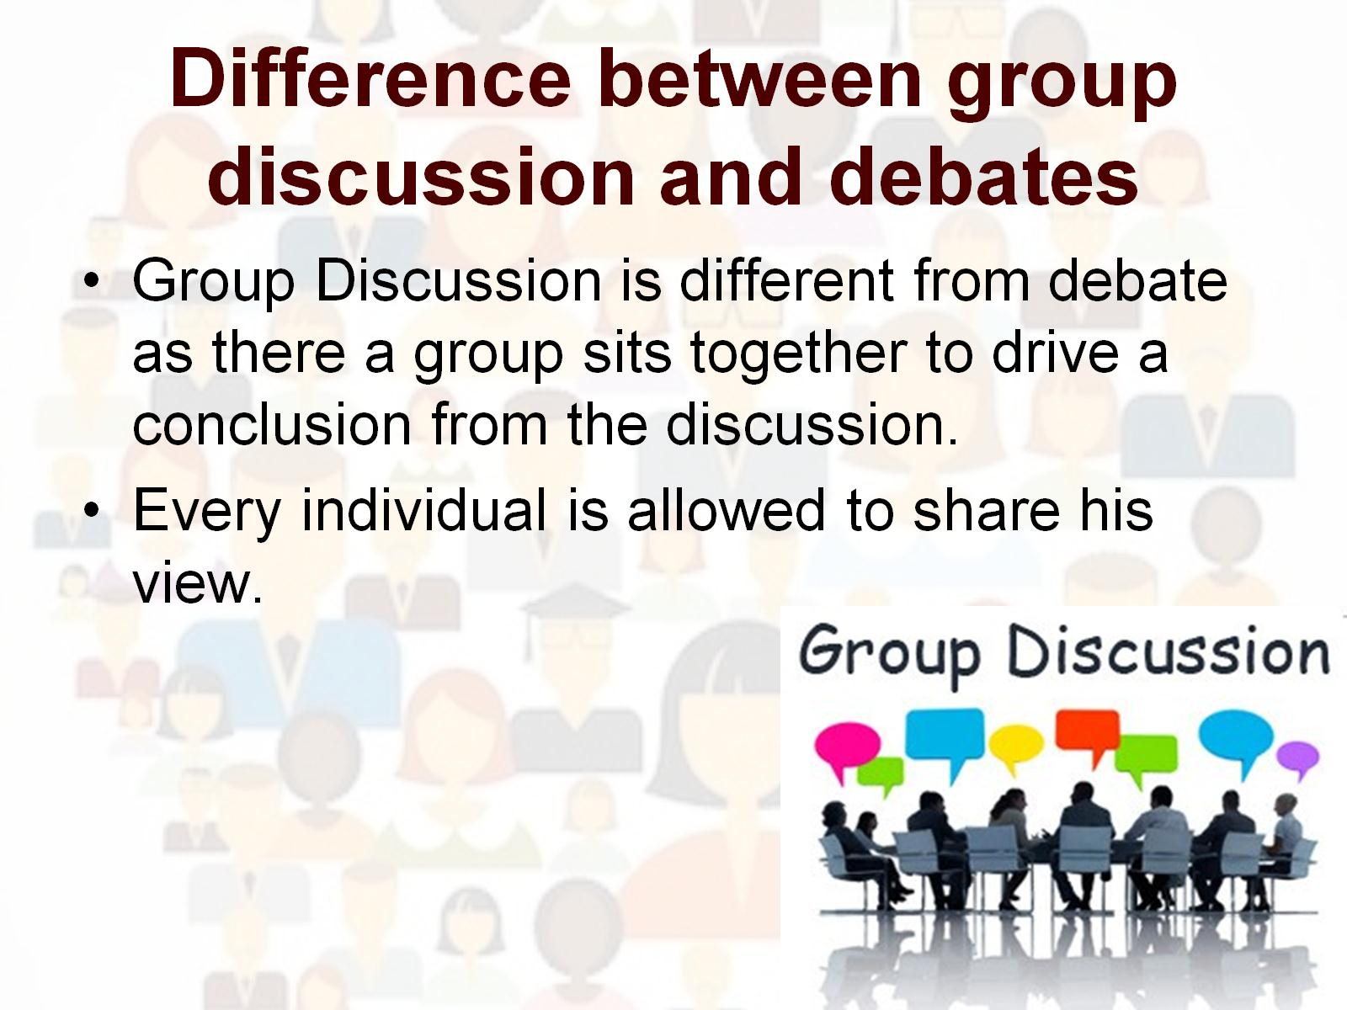
Difference between group discussion and debates

Slide 4
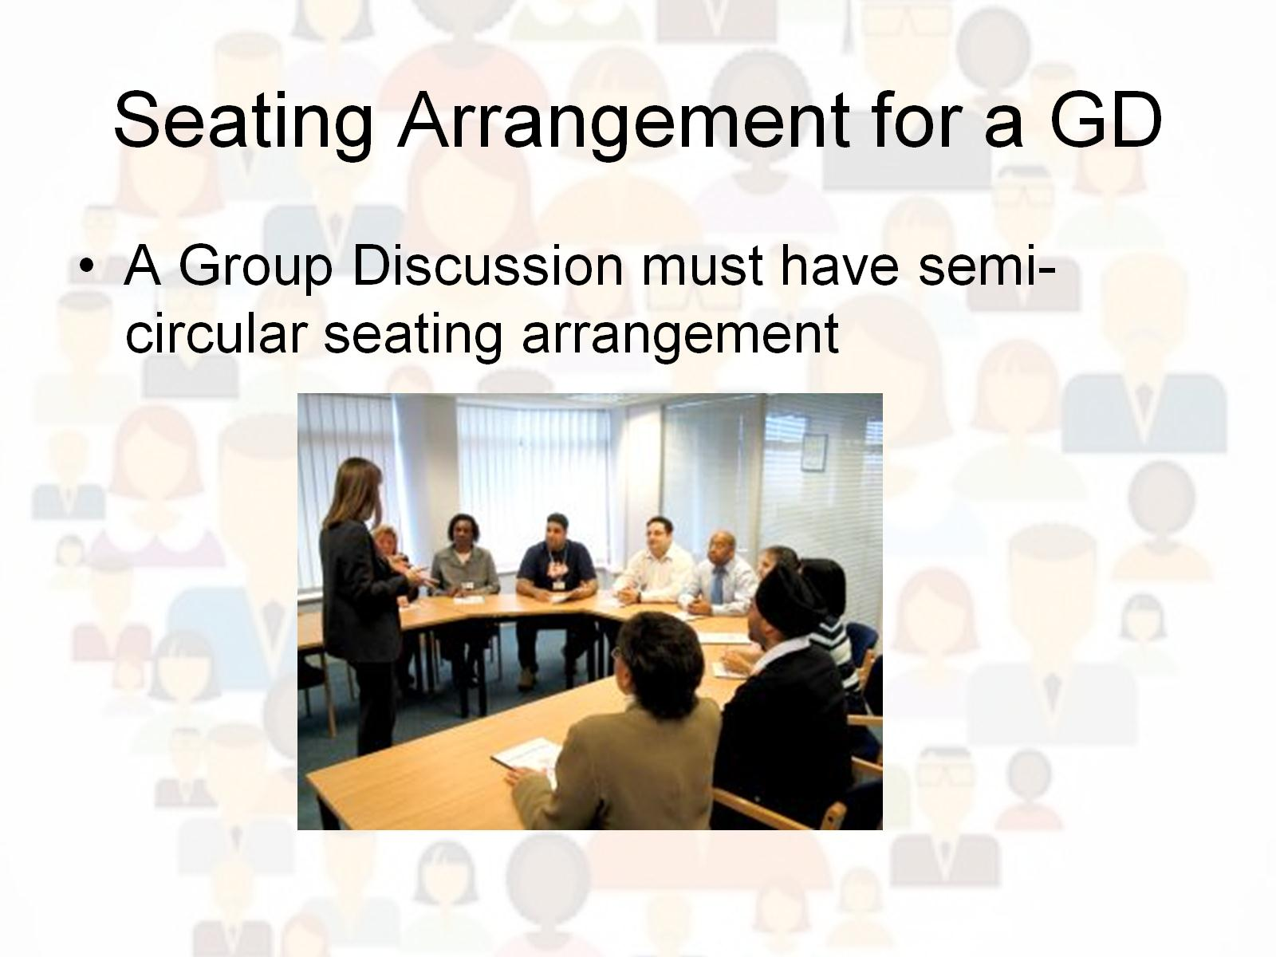
Seating Arrangement for a GD

Slide 5
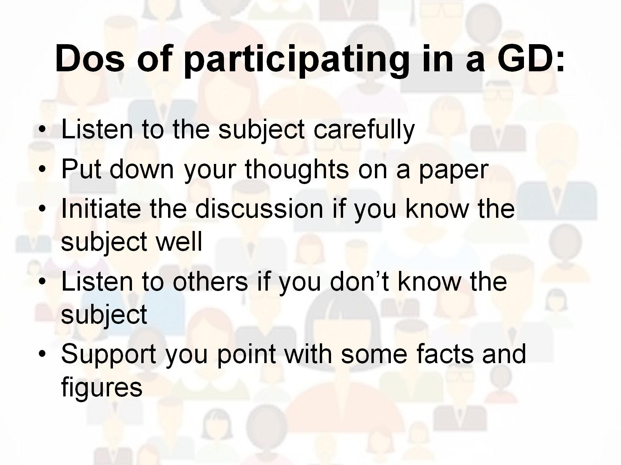
Dos of participating in a GD:

Slide 6
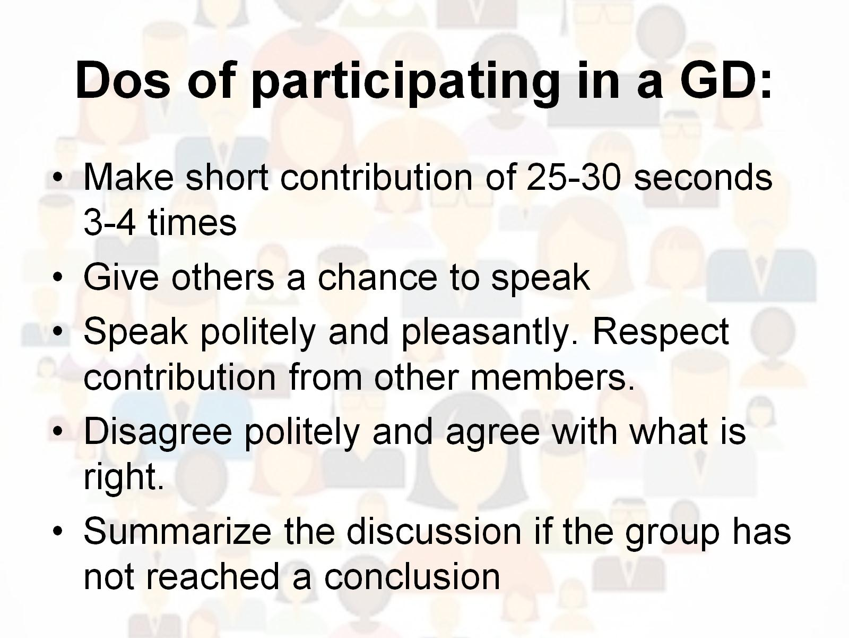
Dos of participating in a GD:

Slide 7
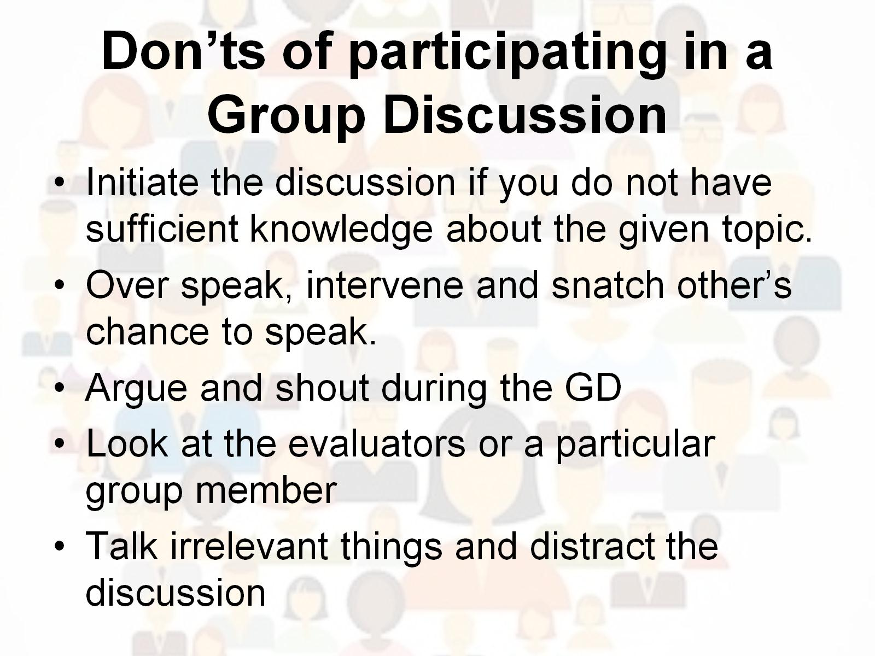
Don’ts of participating in a Group Discussion

Slide 8
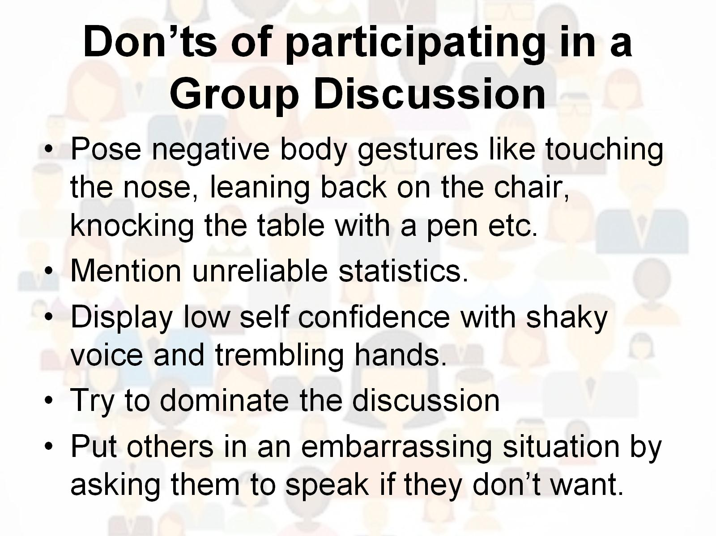
Don’ts of participating in a Group Discussion

Slide 9
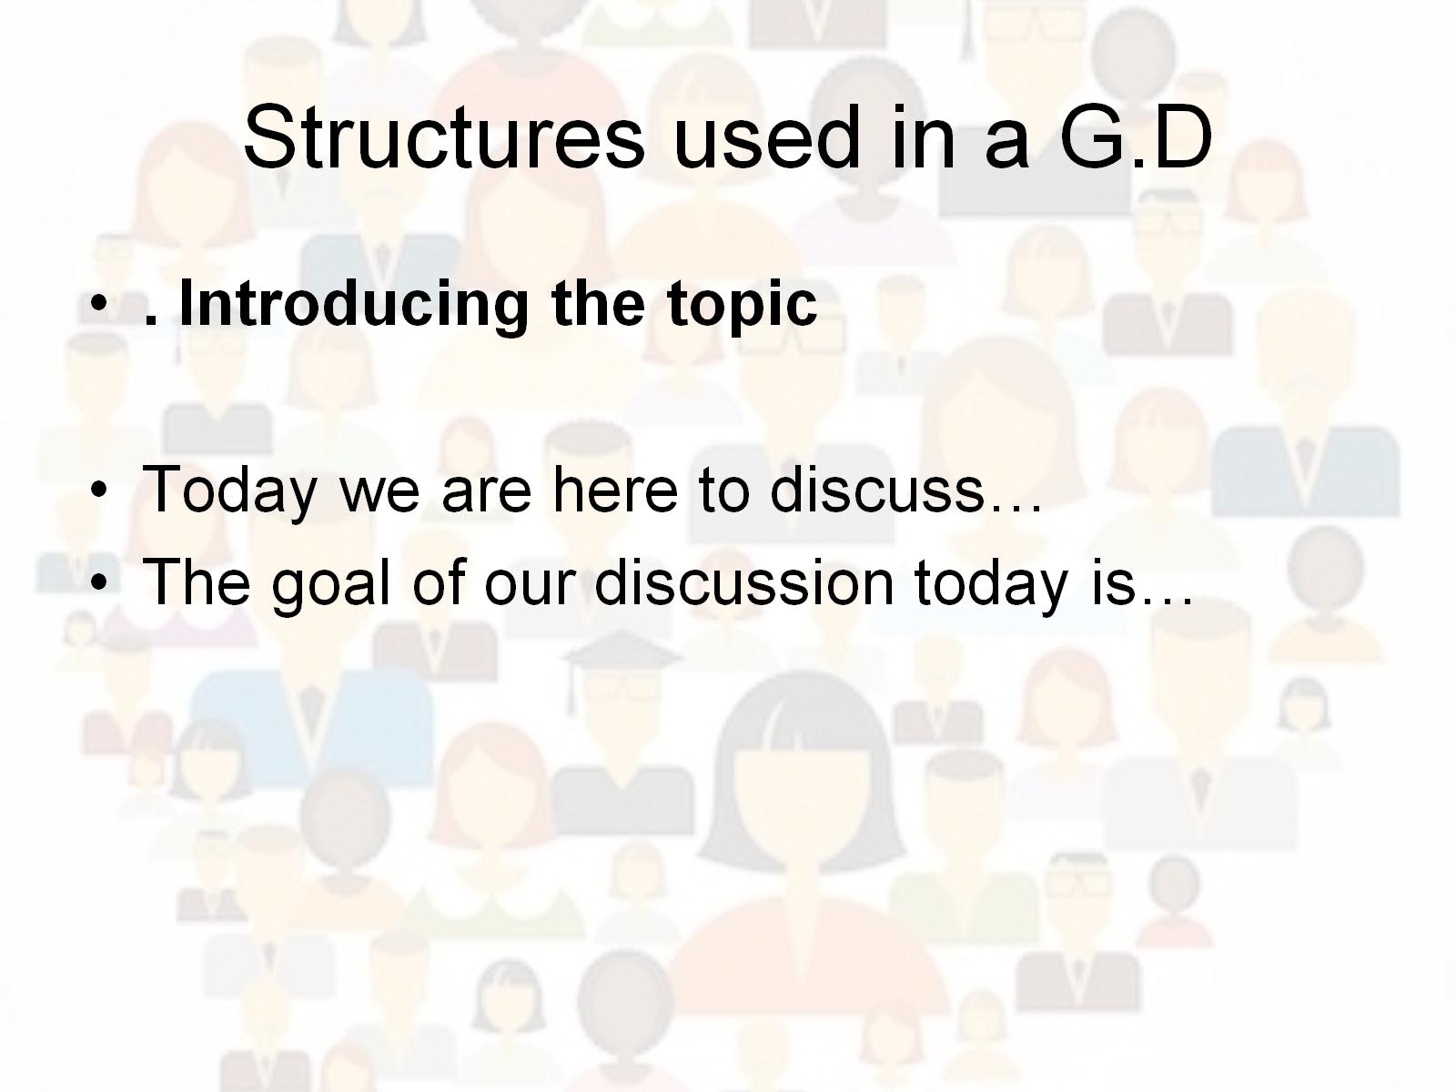
Structures used in a G.D

Slide 10
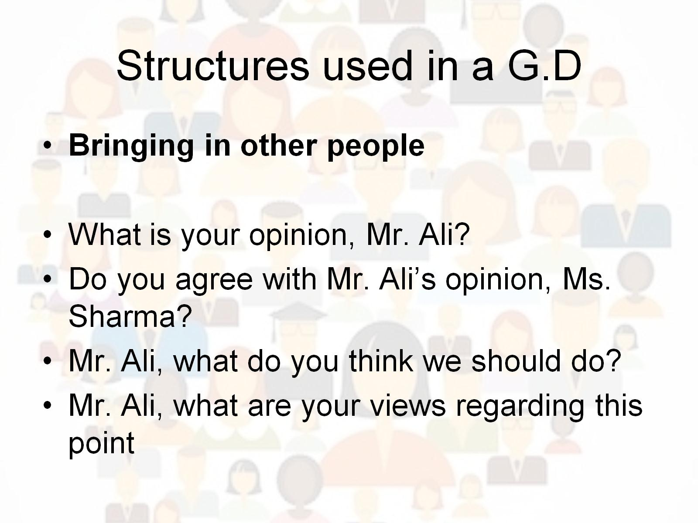
Structures used in a G.D

Slide 11
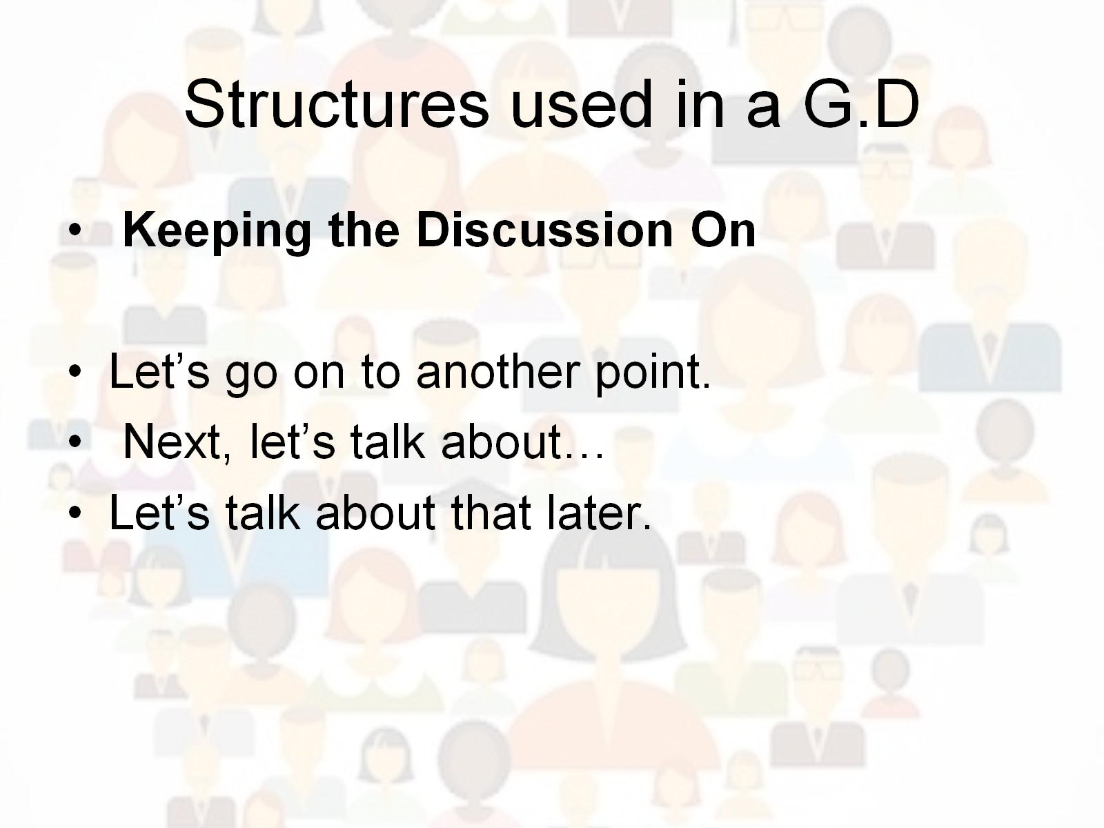
Structures used in a G.D

Slide 12
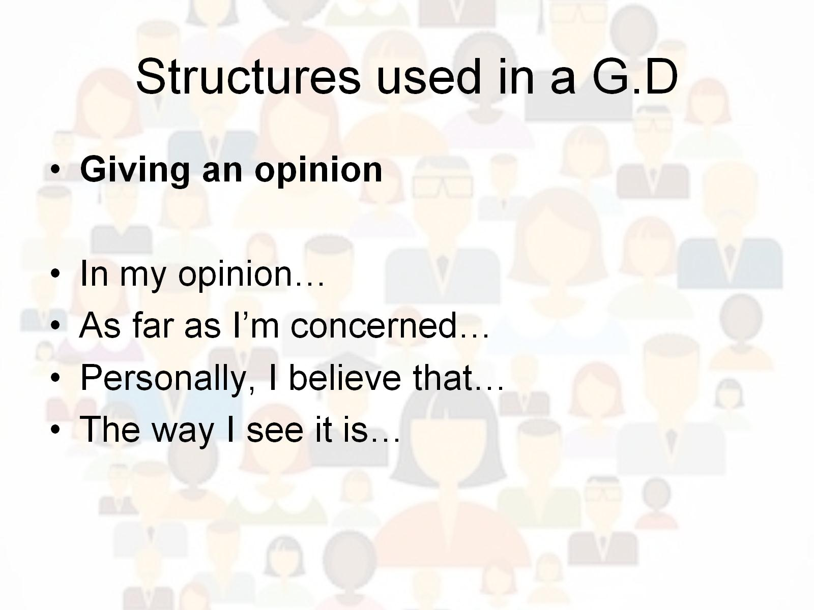
Structures used in a G.D

Slide 13
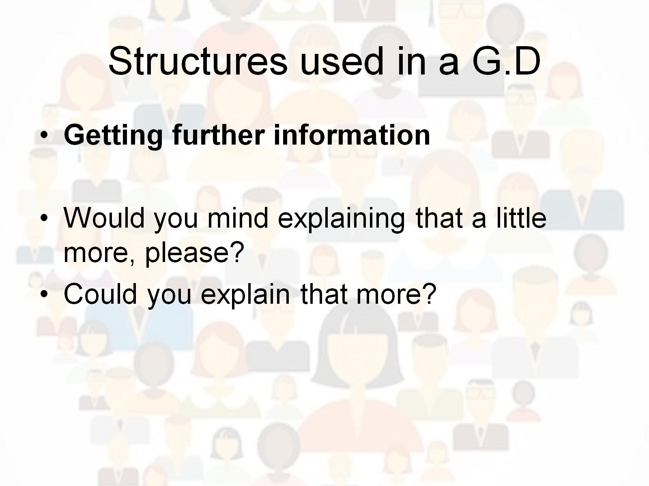
Structures used in a G.D

Slide 14
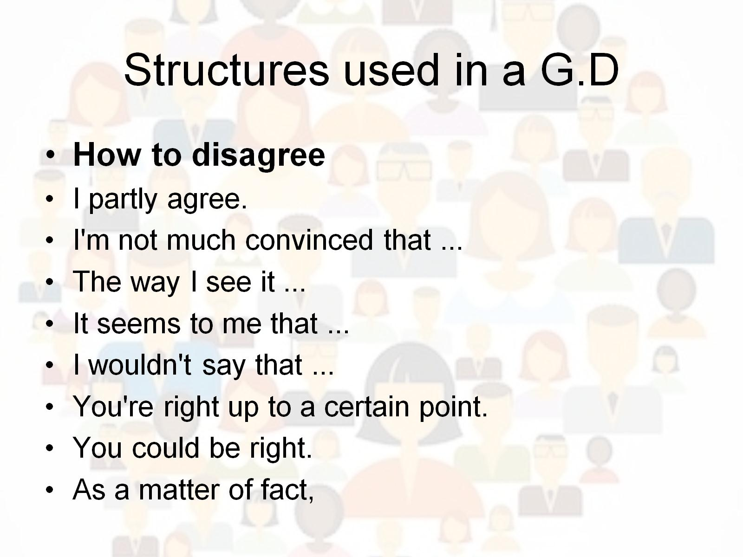
Structures used in a G.D

Slide 15
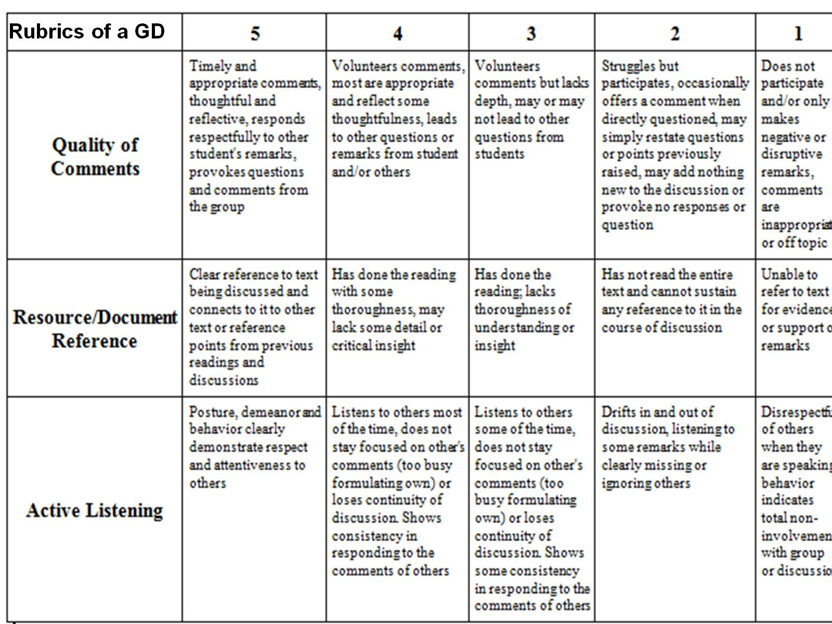

Slide 16


